Slide 1




Getting Started with BoxLang
www.intothebox.org

Slide 2









Developer Evangelist
Raymond Camden
@raymondcamden
raymondcamden@gmail.com
@cfjedimaster
BoxLang Developer Evangelist
Enterprise Cat Demo Builder
Blogging at raymondcamden.com

Slide 3




Slide 4
Game Plan
What?
Why?
How?

Slide 5
What is BoxLang?
Lightweight (6MB!) dynamic, loosely typed language
Built on the JVM
Runs everywhere
Extensible
Can replace ColdFusion/Lucee installs
Open Source 🎉
Free 🎉🎉🎉🎉🎉

Slide 6
What?
Subscriptions for additional support
Premium modules
OS ➡️ BoxLang+ ➡️ BoxLang++ ➡️ Custom
Plans - https://www.boxlang.io/plans

Slide 7
What (Soonish)?
BoxLang Admin
Electron app running ColdBox
More modules

Slide 8
Why?
CLIs and tooling
Serverless APIs
Web Applications (with powerful framework)

Slide 9
How?
Install the JDK (21+ minimum)
Install the binaries (Doc)
Install the IDE (Doc)
CLI tools: boxlang, install-bx-module, boxlang-miniserver, install-boxlang

Slide 10

How?
Carefully read the docs
Ensure you understand everything
Then carefully write your first file
or...
Notes:
Ray, switch to editor, show helloWorld.bxs, run it

Slide 11
Language Features
Java interop (very, very deep)
Classes (full OO, interfaces, abstract, static, etc)
Closures + Pure functions (lambdas)
Immutable classes
Interceptors for the language
Case insensitive
Human operators (AND, OR, etc)
Notes:
Can extend java class

Slide 12
Language Features (More)
Member functions
Mostly optional semicolons (but use them cuz I said so)
Multiline strings + Expression Interpolation
Tag islands
Modular (PDF, Mail, Python, and more...)
Arrays that start at freaking 1 because it makes sense!!
Notes:
Can extend java class

Slide 13
Language Features (Types)
Array, Struct, String, Numeric, DateTime
Query, File, XML
List
Full List (Docs)
Notes:
remember that the core types wrap java obs and add stuff on top
show array example - https://boxlang.ortusbooks.com/boxlang-language/reference/types/array

Slide 14
Language Features (More)
Some functionality exposed as components
For example: bx:http .... { subtags }
For example: bx:mail somearg=1 { content }
Notes:
remember that the core types wrap java obs and add stuff on top
show array example - https://boxlang.ortusbooks.com/boxlang-language/reference/types/array

Slide 15
Language Features (Scopes)
variables (all)
server (all)
application, session, form, url (web)
request (web)
this (components)
local, arguments (functions)
More: Docs
Notes:
remember that the core types wrap java obs and add stuff on top
show array example - https://boxlang.ortusbooks.com/boxlang-language/reference/types/array

Slide 16
BoxLang Files
bxs (scripting)
bxm (tag)
bx (classes)
Notes:
Can extend java class

Slide 17
Demo
Ray, show the tag/class versions of hello world...
Notes:
Can extend java class

Slide 18
Building for the CLI
For interaction, use: cliGetArgs(), cliRead(), cliExit()
Also server.cli.parsed
Positionals and Options
For classes, main is automatically run
https://boxlang.ortusbooks.com/getting-started/running-boxlang/cli-scripting
Notes:
remember that the core types wrap java obs and add stuff on top
show array example - https://boxlang.ortusbooks.com/boxlang-language/reference/types/array

Slide 19
CLI Args - Options
--option (option is true)
--option=X (option is X)
-o=X (shorter)
--!option (option is false)
--no-option (option is false)
Notes:
remember that the core types wrap java obs and add stuff on top
show array example - https://boxlang.ortusbooks.com/boxlang-language/reference/types/array

Slide 20
Demo
Ray, show the cli* files
Notes:
Can extend java class

Slide 21
Building for Serverless
Currently only AWS Lambda (but more coming soon)
BoxLang template (skeleton code, unit tests, GitHub actions)
Template adds automatic event management and response serialization
Can upload a zip or use GitHub Actions 🎉
Notes:
remember that the core types wrap java obs and add stuff on top
show array example - https://boxlang.ortusbooks.com/boxlang-language/reference/types/array

Slide 22
Building for Serverless
Make a new repo based on template and edit settings
Create your Lambda on the AWS side (settings are important!)
Work on code
Use unit test to confirm
Git commit and wait
Notes:
remember that the core types wrap java obs and add stuff on top
show array example - https://boxlang.ortusbooks.com/boxlang-language/reference/types/array

Slide 23
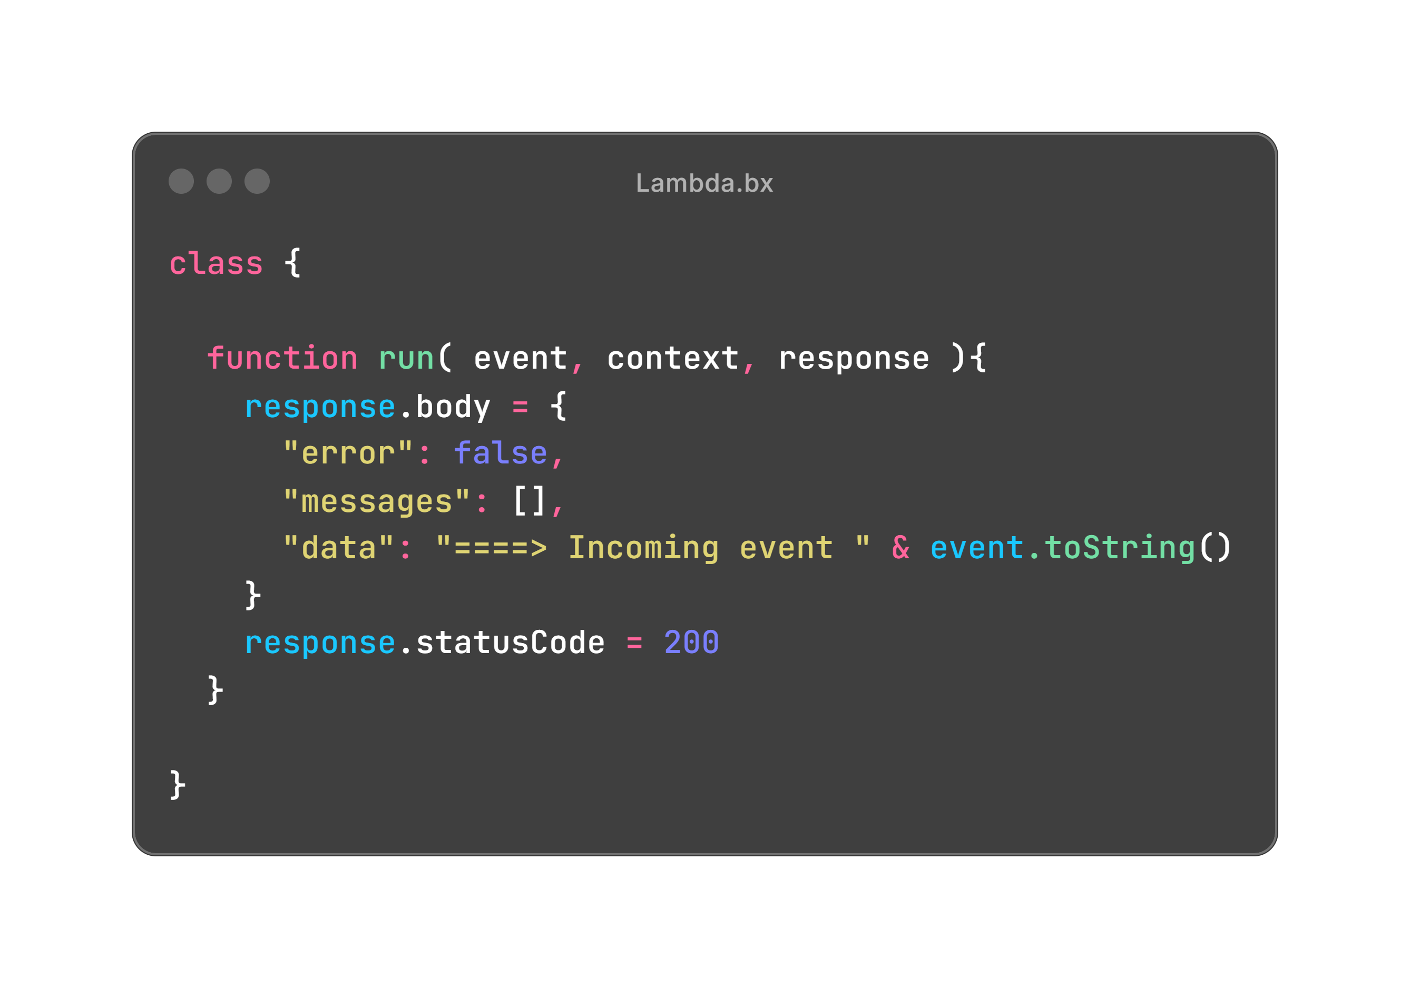
Building for Serverless
Notes:
remember that the core types wrap java obs and add stuff on top
show array example - https://boxlang.ortusbooks.com/boxlang-language/reference/types/array

Slide 24
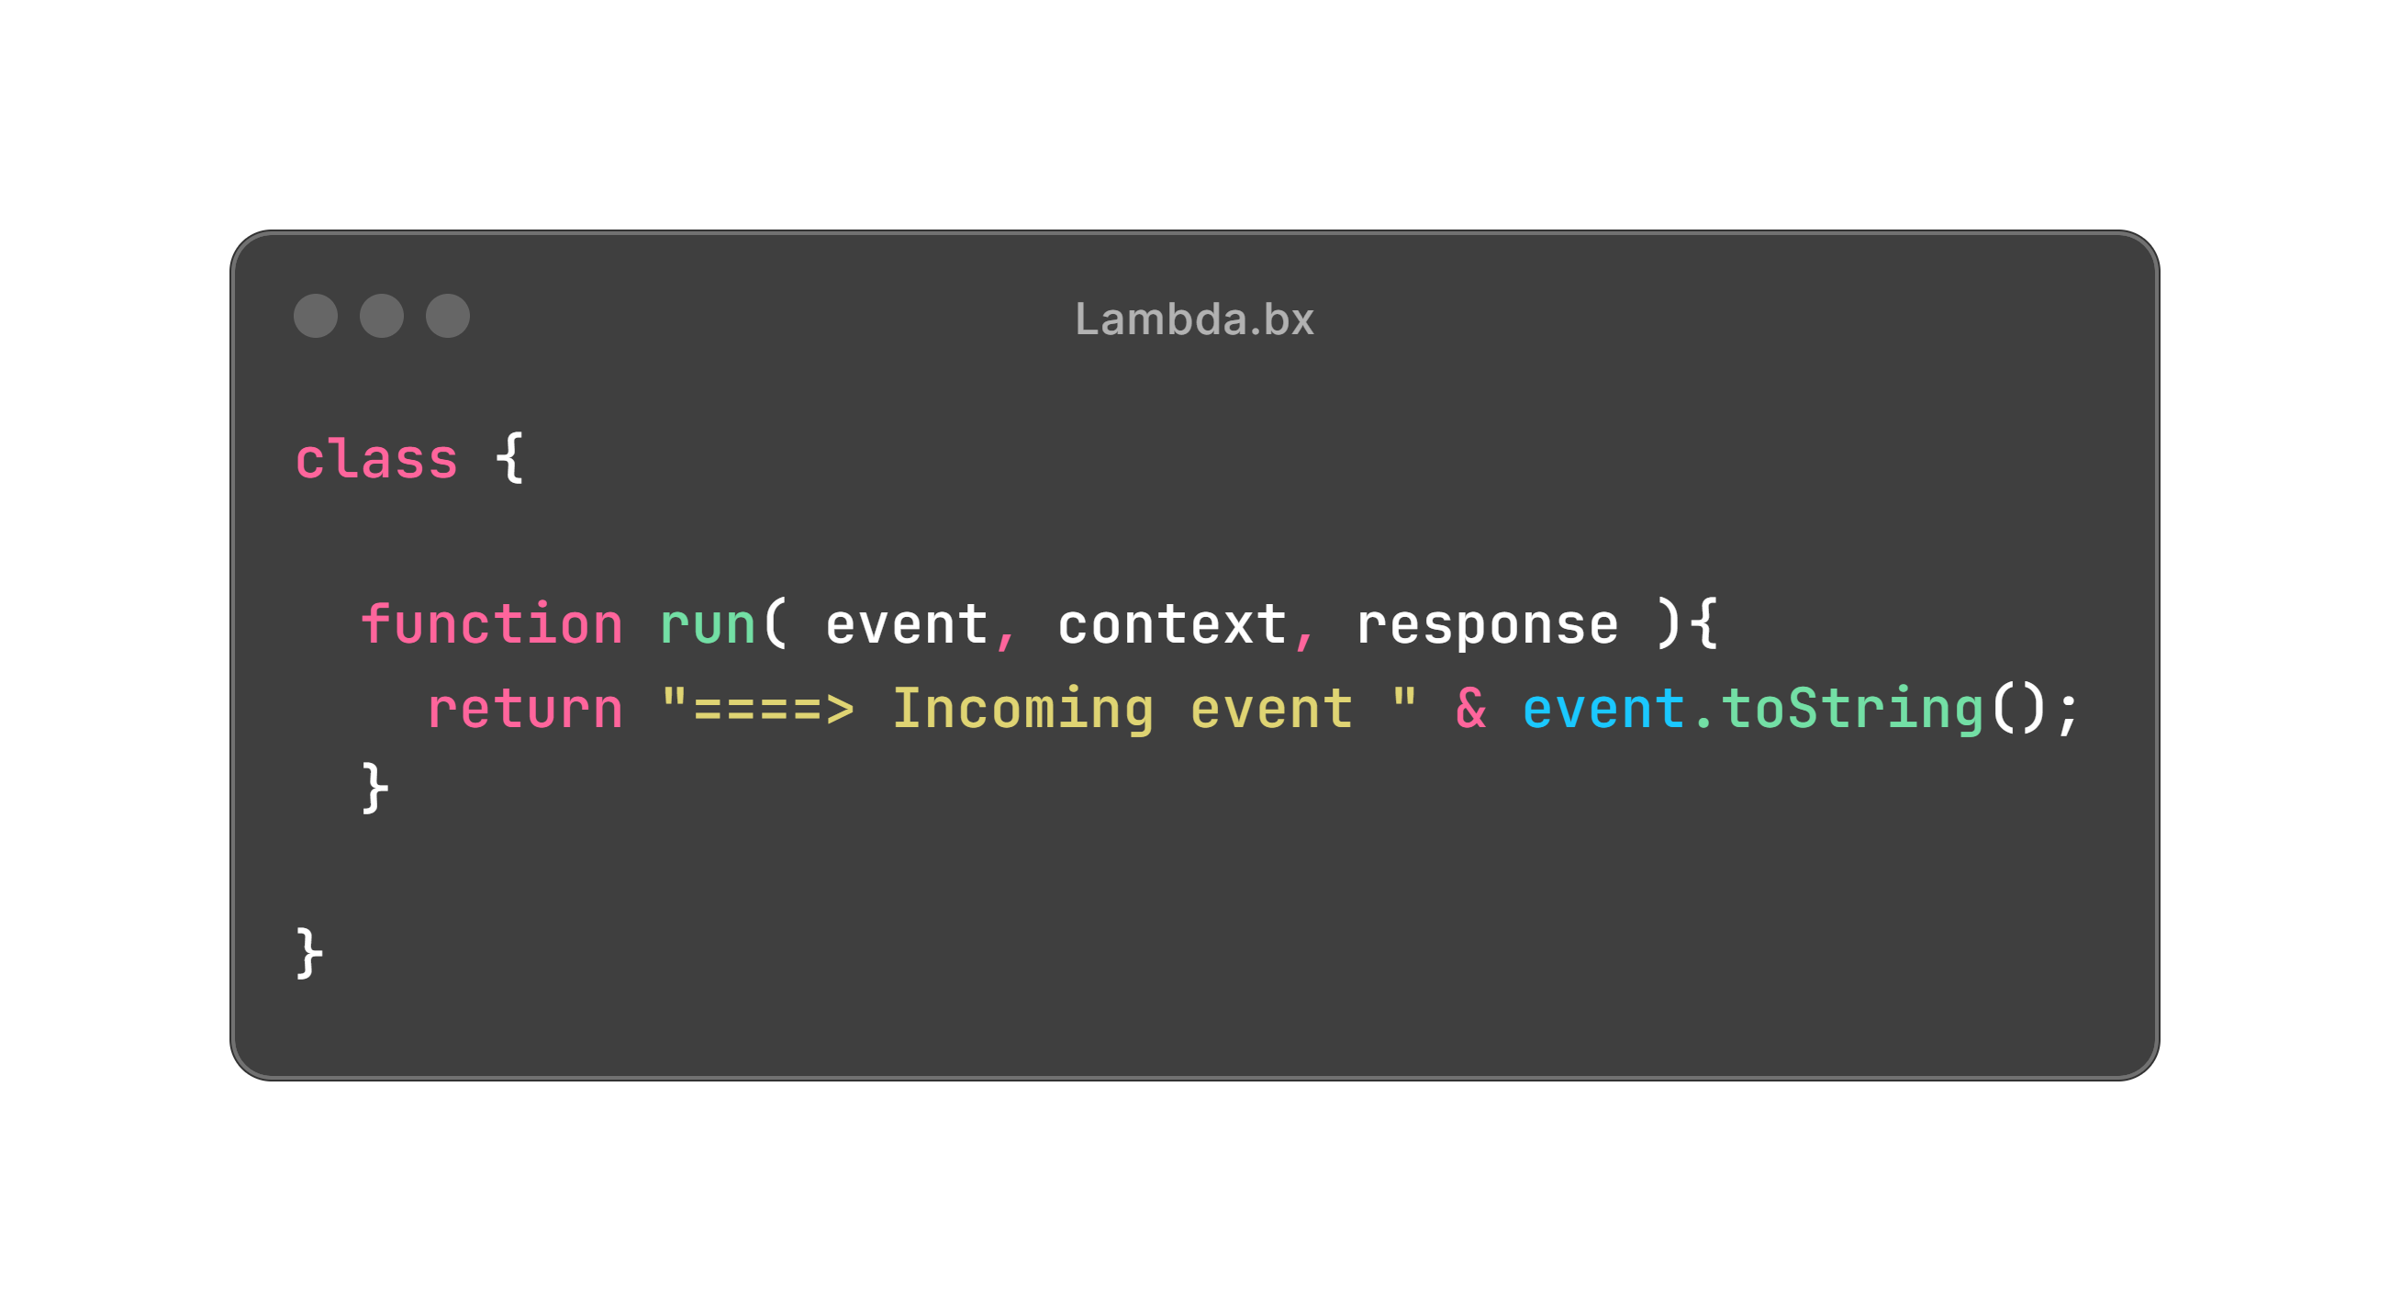
Building for Serverless
Notes:
remember that the core types wrap java obs and add stuff on top
show array example - https://boxlang.ortusbooks.com/boxlang-language/reference/types/array

Slide 25
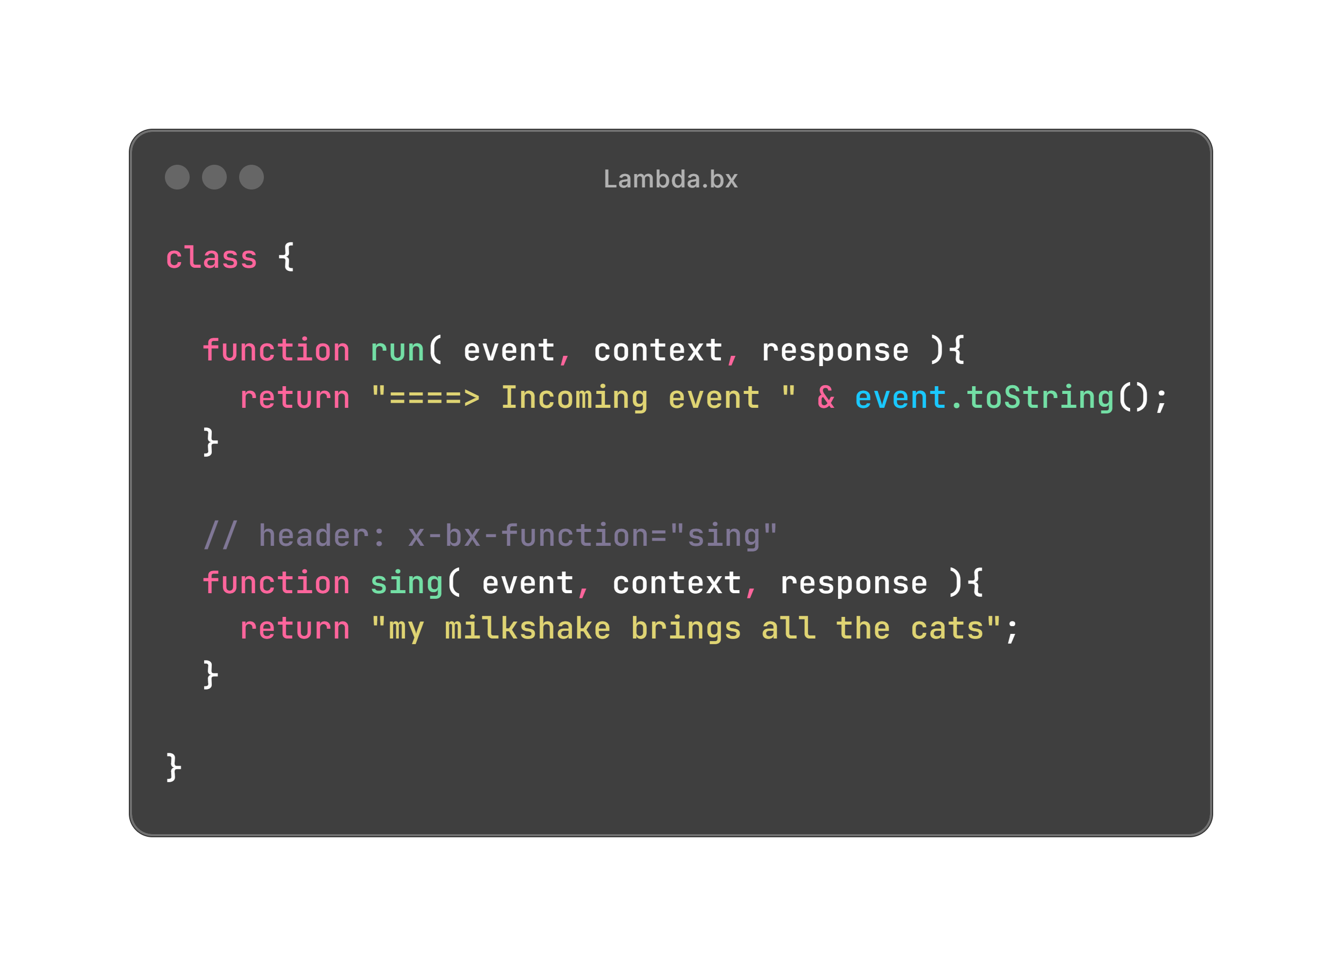
Building for Serverless
Notes:
remember that the core types wrap java obs and add stuff on top
show array example - https://boxlang.ortusbooks.com/boxlang-language/reference/types/array

Slide 26
Demo
Ray, show the local Lambda then the Postman
Notes:
Can extend java class

Slide 27
Building for Serverless
Read the docs: https://boxlang.ortusbooks.com/getting-started/running-boxlang/aws-lambda
Other serverless platforms coming soon
Notes:
remember that the core types wrap java obs and add stuff on top
show array example - https://boxlang.ortusbooks.com/boxlang-language/reference/types/array

Slide 28
Web Apps
Baked In FTW!
Application and Session Management
Application life-cycle event handlers
File-based routing
Classes have additional support for remote operations
Notes:
remember that the core types wrap java obs and add stuff on top
show array example - https://boxlang.ortusbooks.com/boxlang-language/reference/types/array

Slide 29
Web Apps - Defining
Add an Application.bx to the ‘root’ of your app
BoxLang ‘searches’ for this file when a request is made
Application.bx is run on every request
Notes:
remember that the core types wrap java obs and add stuff on top
show array example - https://boxlang.ortusbooks.com/boxlang-language/reference/types/array

Slide 30
Web Apps - Events
Add an Application.bx to the ‘root’ of your app
BoxLang ‘searches’ for this file when a request is made
Application.bx is run on every request
Notes:
remember that the core types wrap java obs and add stuff on top
show array example - https://boxlang.ortusbooks.com/boxlang-language/reference/types/array

Slide 31
Web Apps - Running
CommandBox
MiniServer 🤩
Docker
Notes:
remember that the core types wrap java obs and add stuff on top
show array example - https://boxlang.ortusbooks.com/boxlang-language/reference/types/array

Slide 32
Demo
Ray, show web1
Notes:
Can extend java class

Slide 33
Thank You!
The Future of Modern Development Starts Here, with you! 🚀

